Slide 1
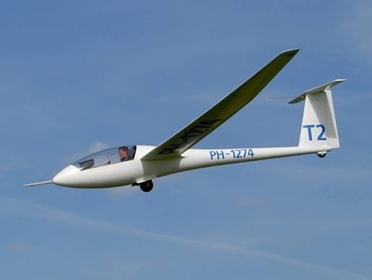
Design of a sailplane with a semi-monocoque wing
I. Aerodynamics and stability
Senadheera H.W.M.L.U.C
230593A
1

Slide 2
Requirements and constraints
Maximize the range of the aircraft.
Wingspan (b) : 12m - 18m
Fuselage length : 45-55% of the wingspan
Mass of complete aircraft : 250kg - 300kg
2

Slide 3
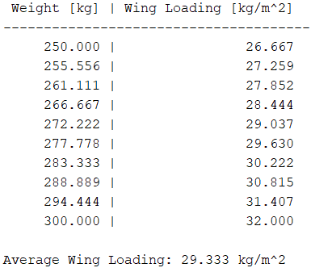
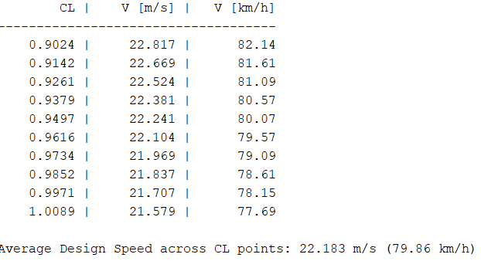
Determining the initial parameters
AR = 24
Wing Span = 15m
Calculated paramters
Wing Area (S) = 9.375 m^2
Mean chord ( c ) = 0.625 m
Wing Loading = 29.333 kg/m^2
Design Weight = 275.000 kg (2697.75 N)
Cruise speed = 22.183 m/s (79.86 km/h)
3

Slide 4
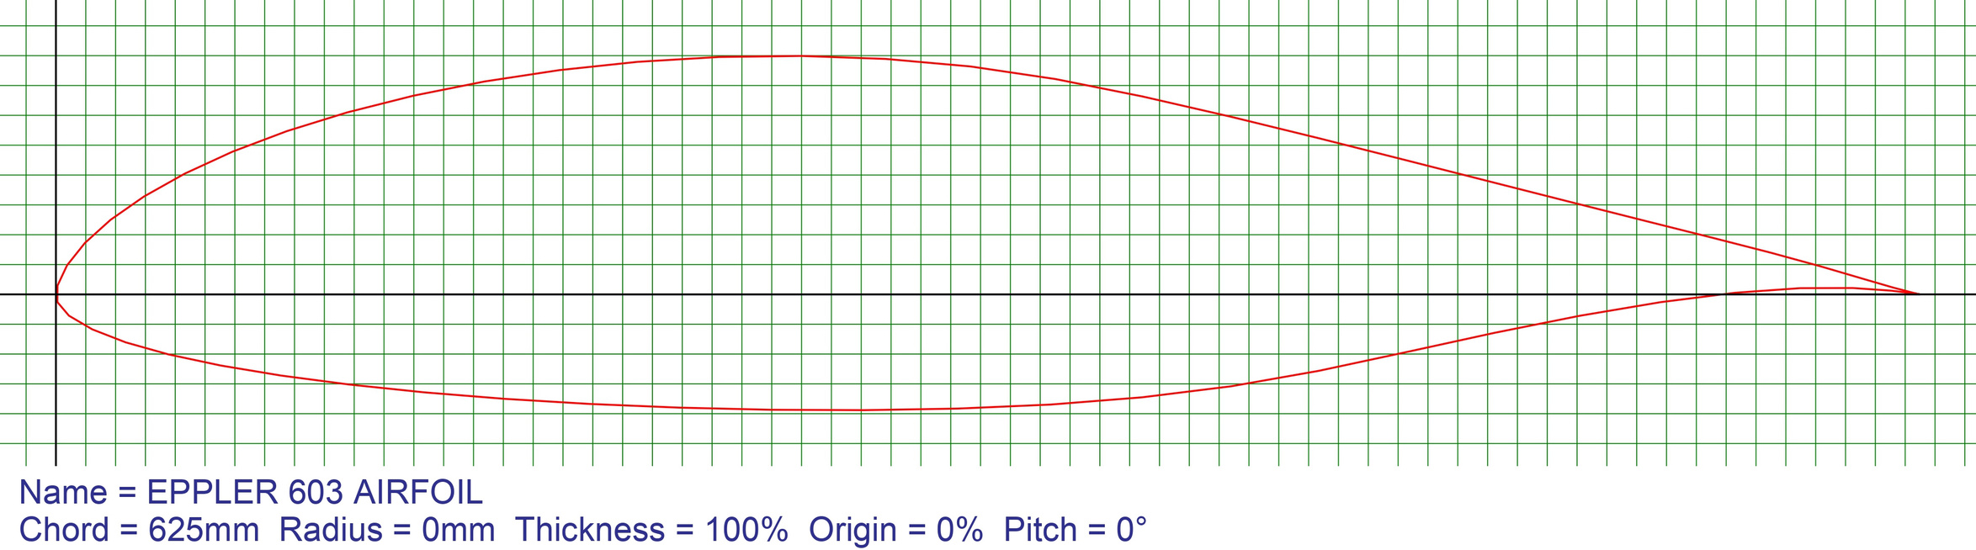
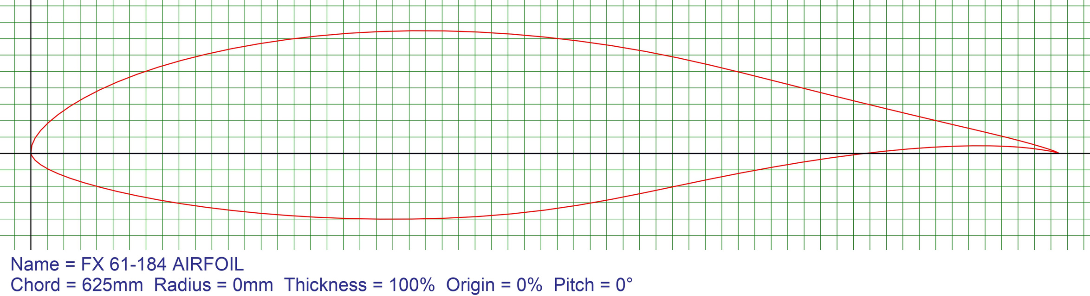
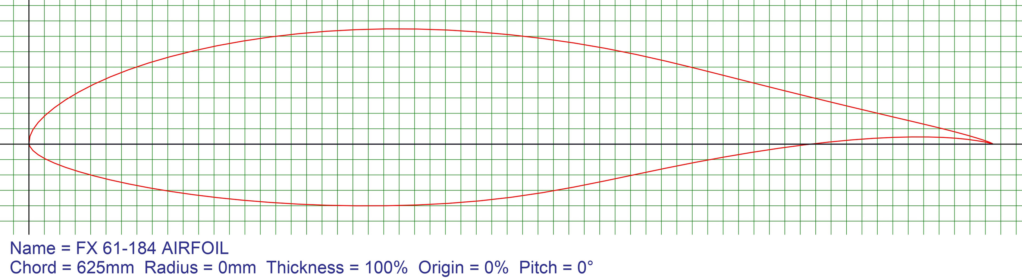
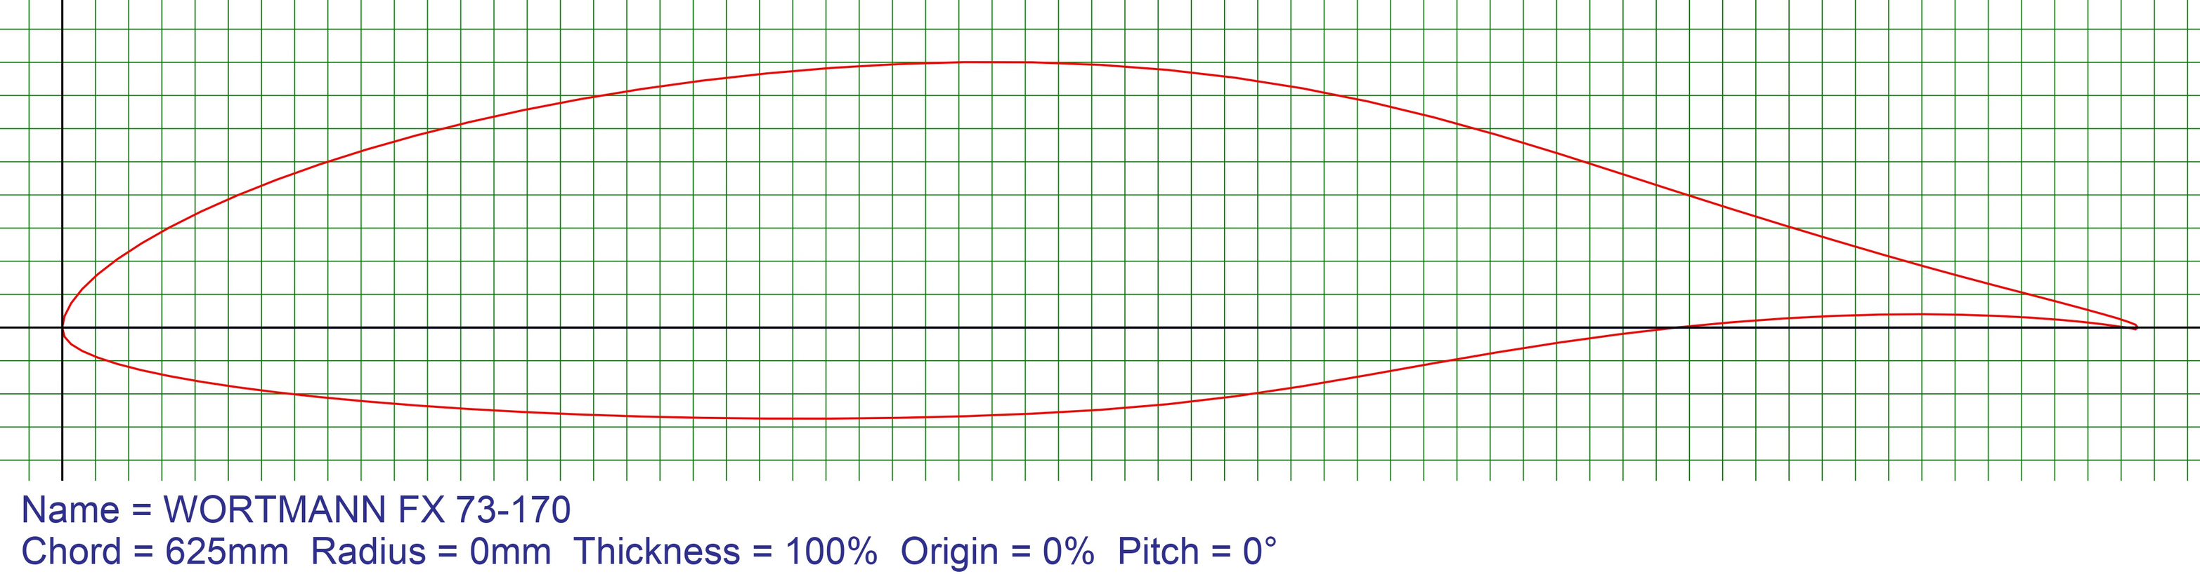
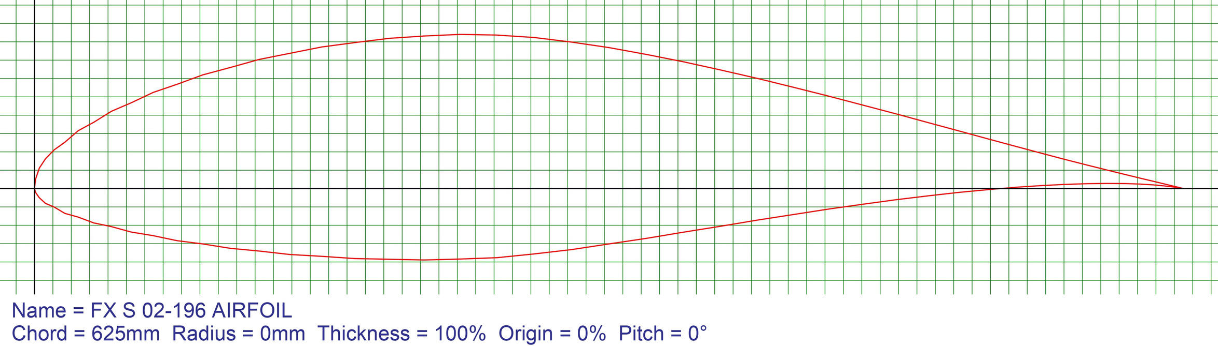
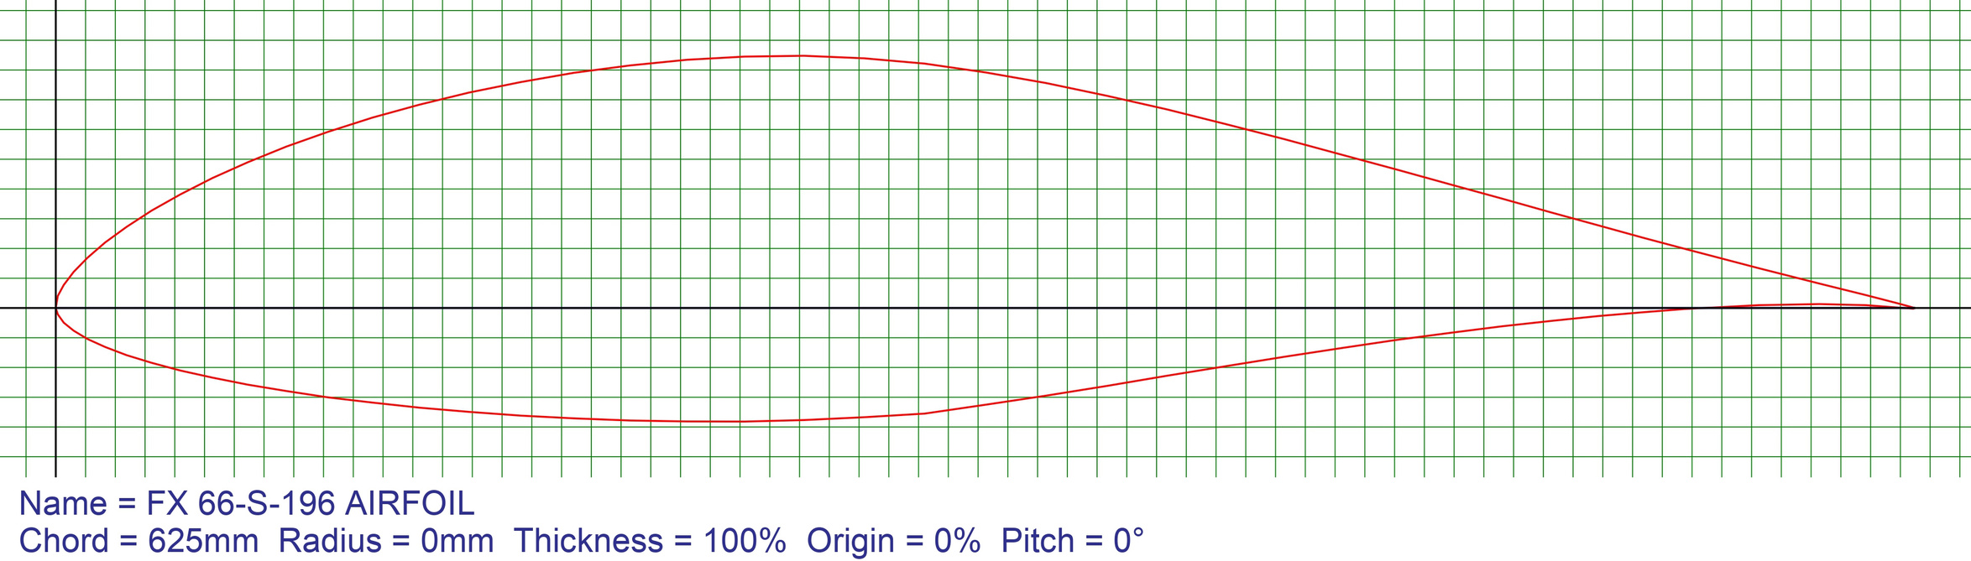
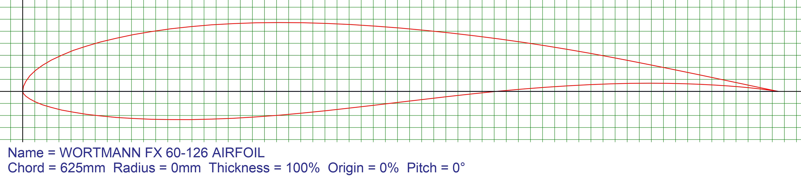
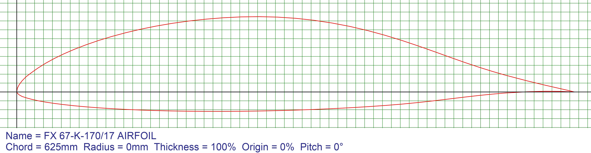
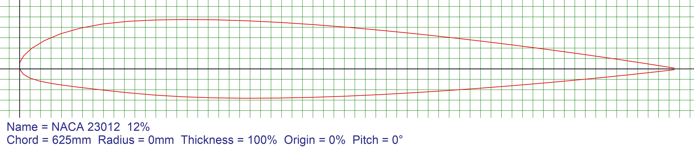
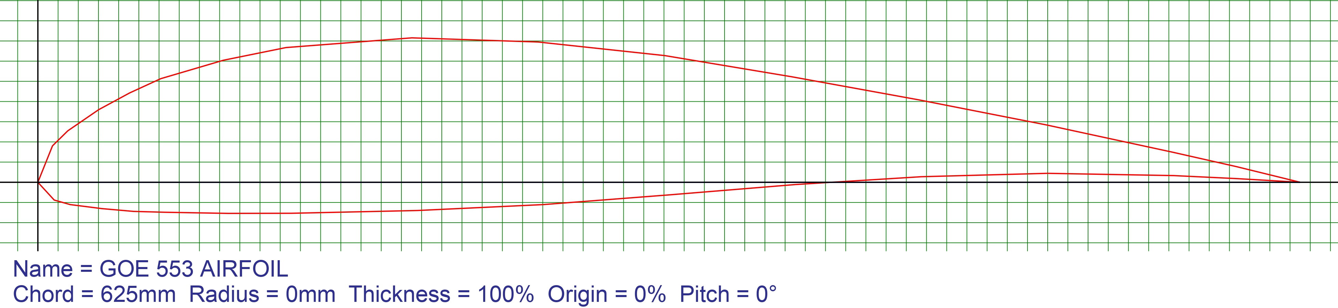
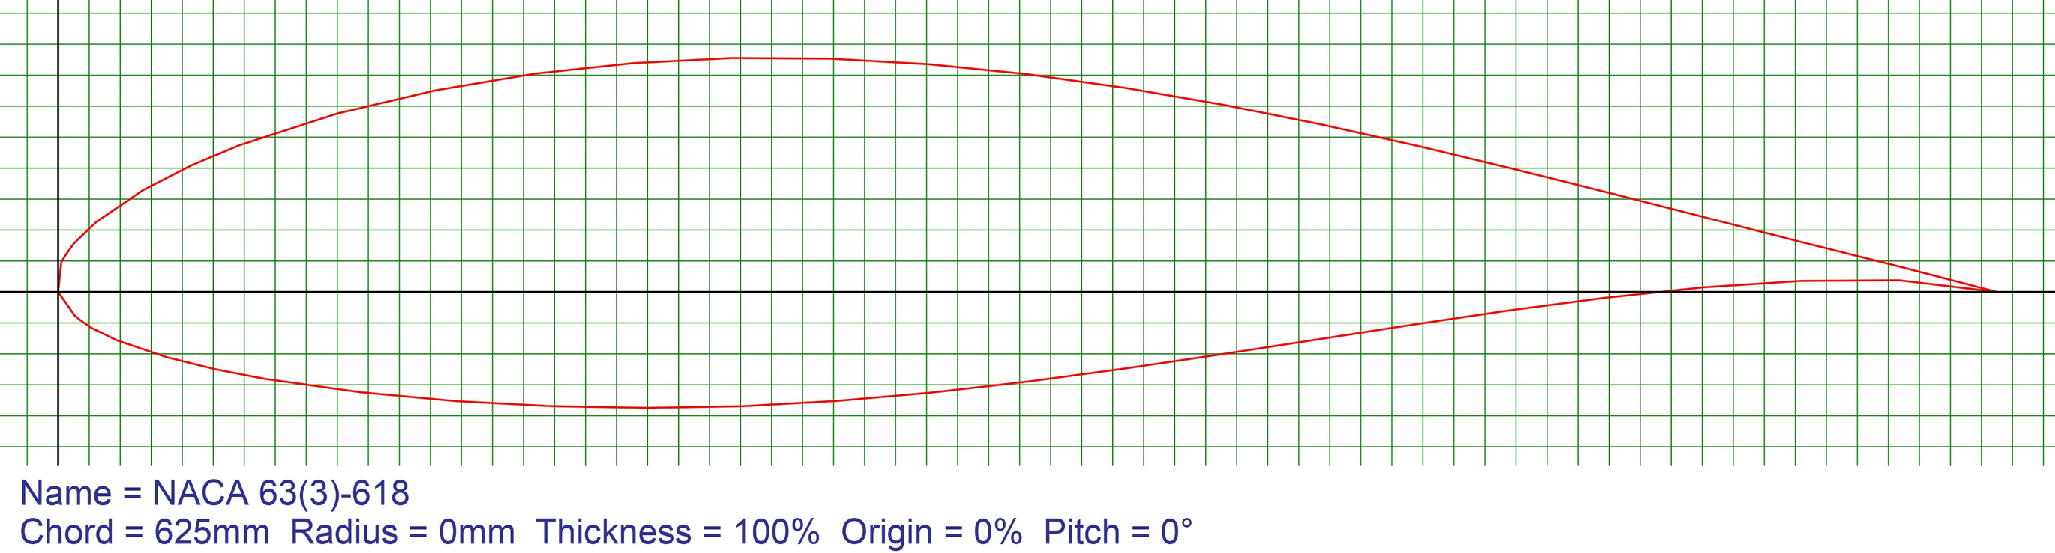
Airfoil Selection for Wing
E603
FX66S196
FX67K170
FX73K170
FX60126
FX61184
FXS02196
GOE533
GOE549
NACA23012
NACA636318
4

Slide 5
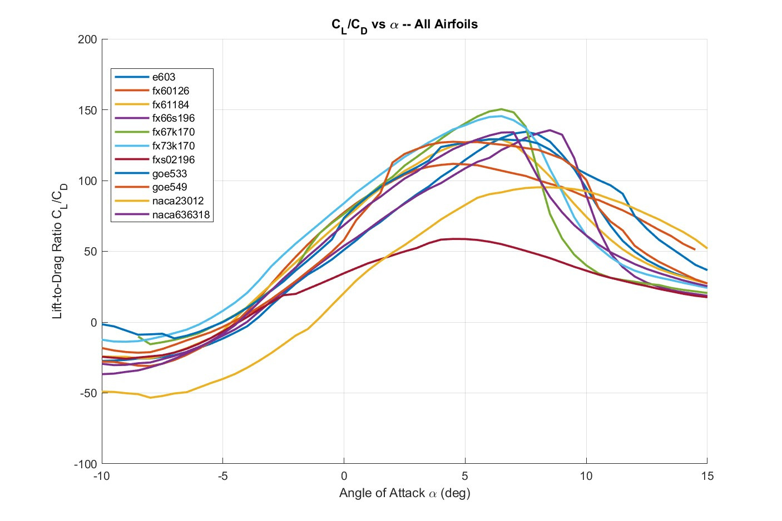
5

Slide 6
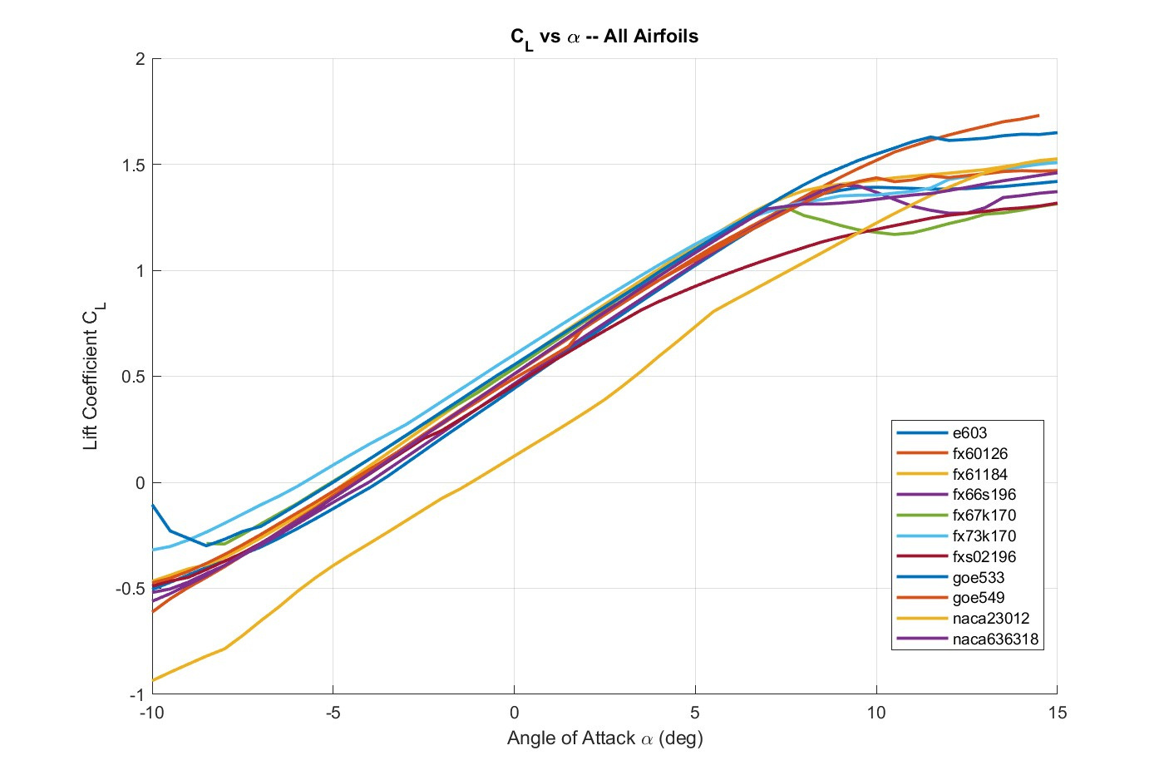
6

Slide 7
7

Slide 8
8

Slide 9
Airfoils Selected
FX67K170
FX73K170
FX60126
FX61184
GOE533
9

Slide 10
Decision Matrix
10

Slide 11
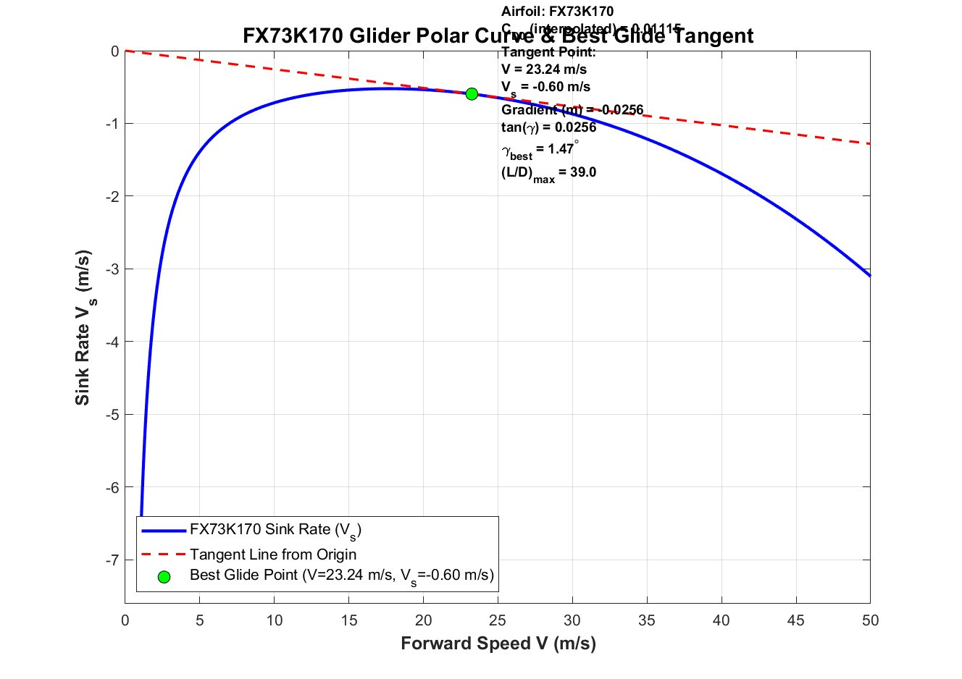
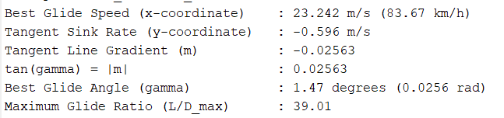
11

Slide 12
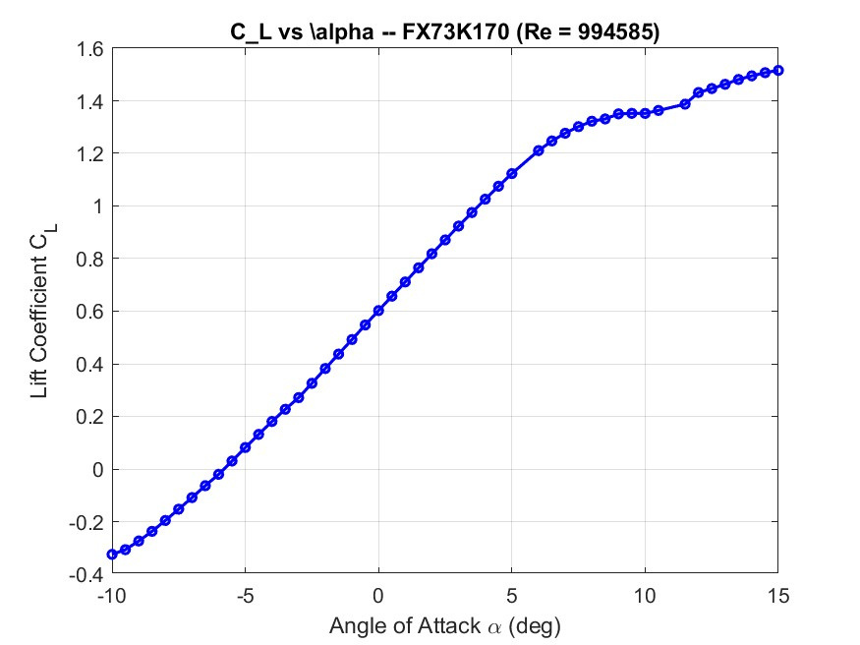
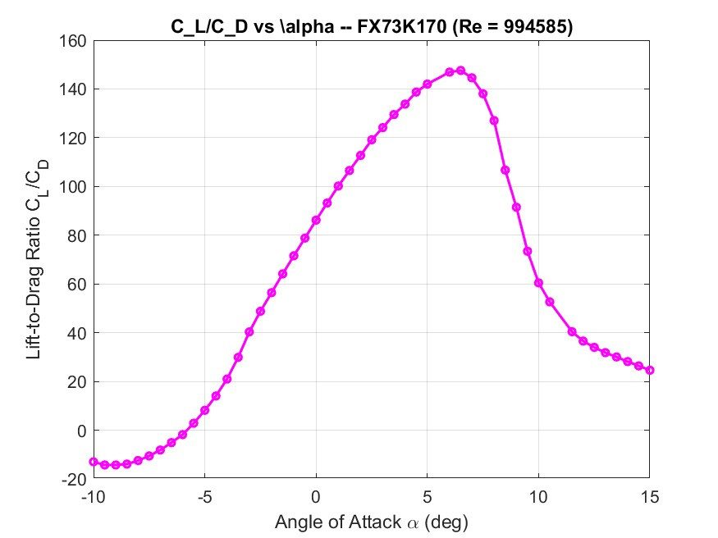
12

Slide 13
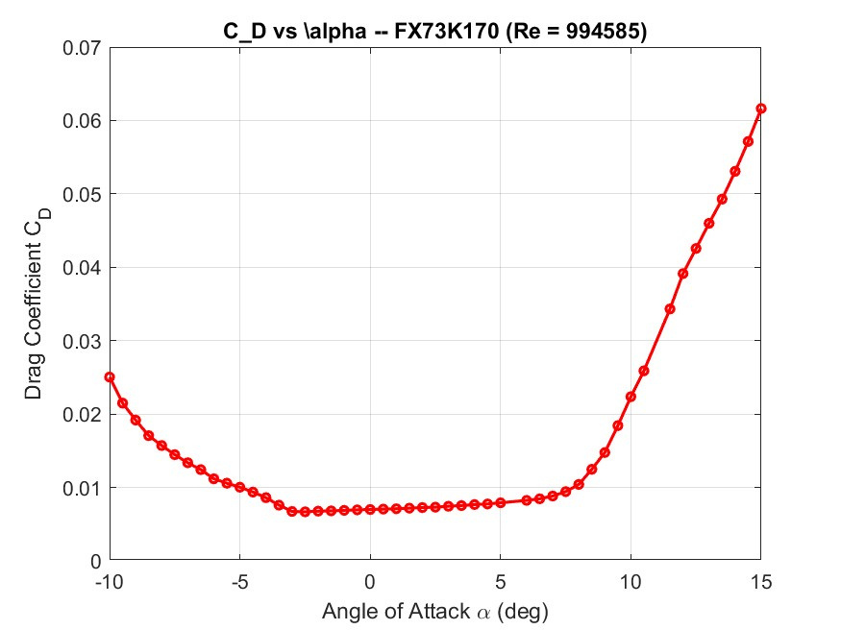
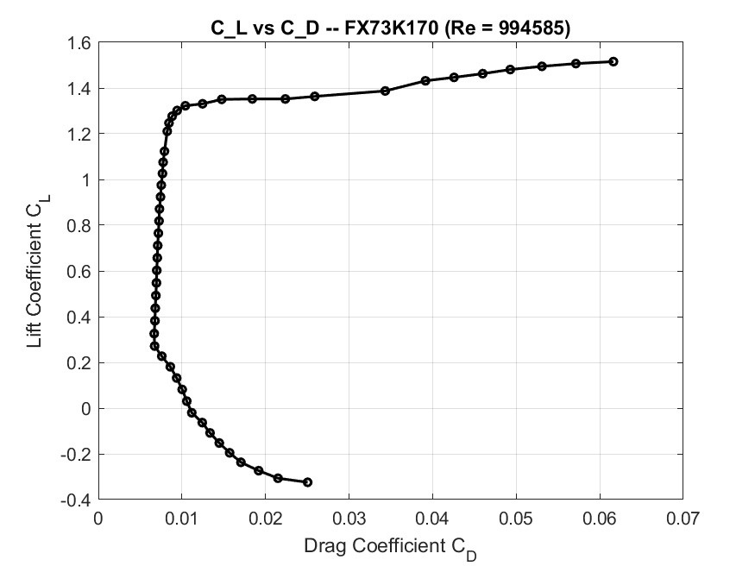
13

Slide 14
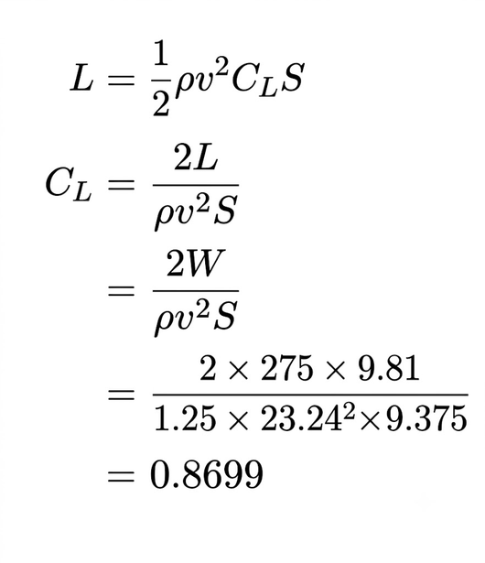
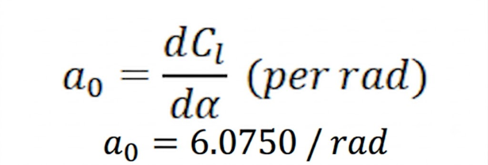
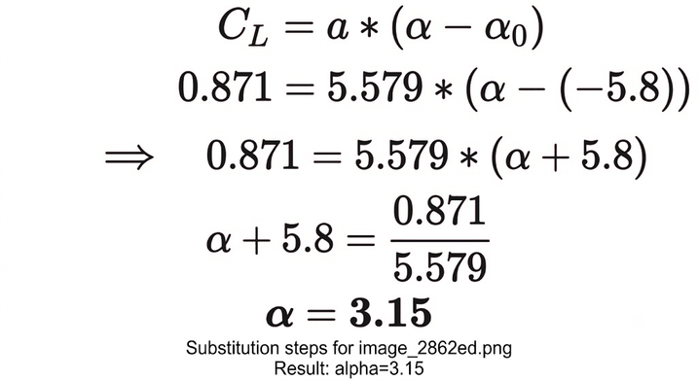
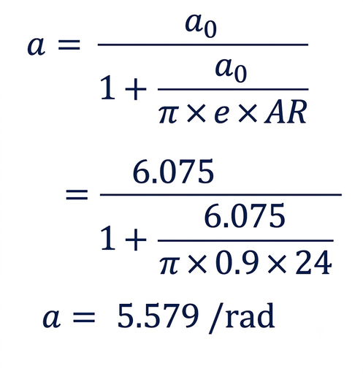
Angle of attack of airfoil and wing
Recuired CL
Infinite wing (2D aerofoil) lift curve slope, 𝑎0
AoA of wing
IFinite wing lift curve slope; 𝑎 :
AoA of airfoil matched = 2.50 0
At 2.50 0
Cl = 0.8710
Cd = 0.00731
Cl/Cd = 119.15
Generated Lift (L) = 2701.27 N
Zero-Lift Alpha (alpha0): -5.80 deg
14

Slide 15
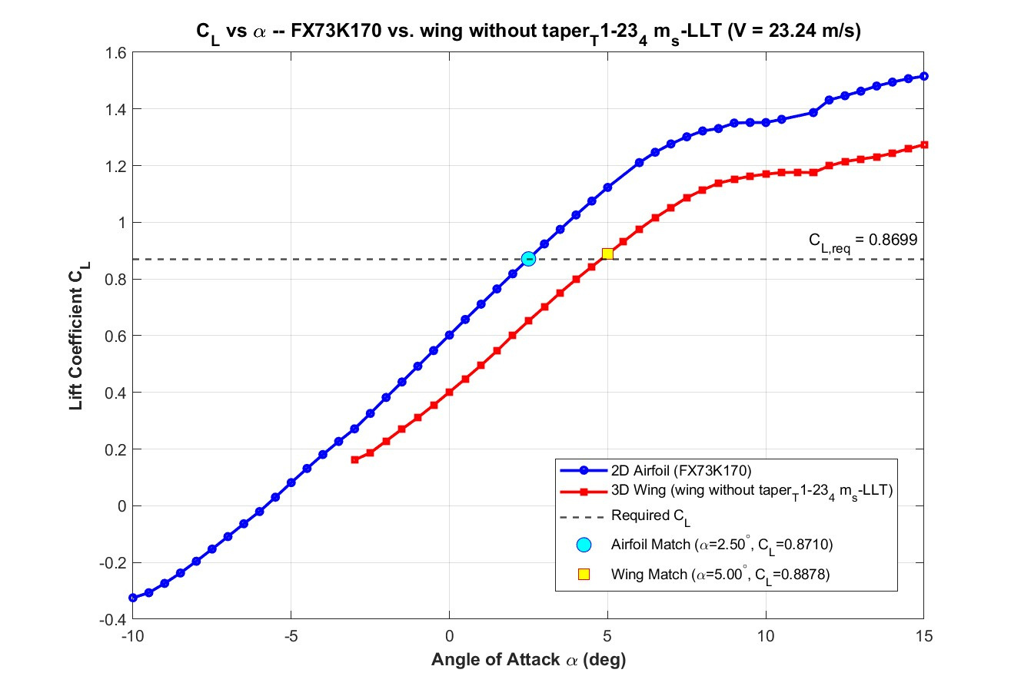
Using XFLR 5..
Angle of attack of wing =5 deg
15

Slide 16
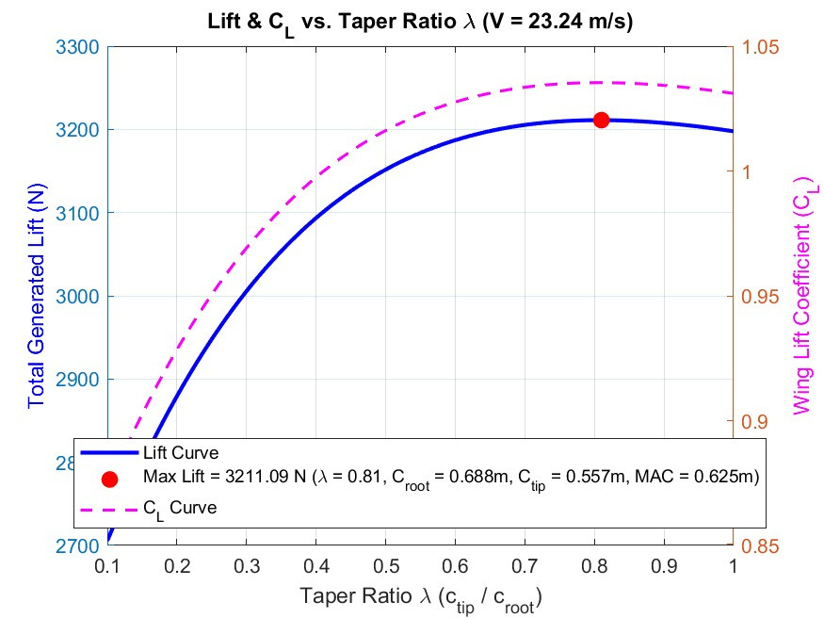
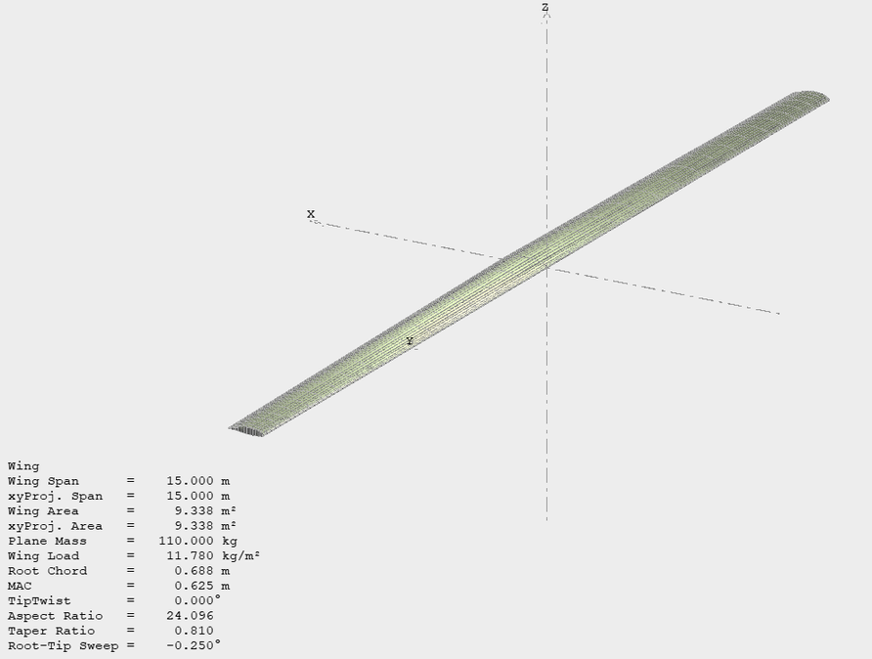
Taper Ratio
Prandtl’s Lifting-Line Theory (LLT)
16

Slide 17
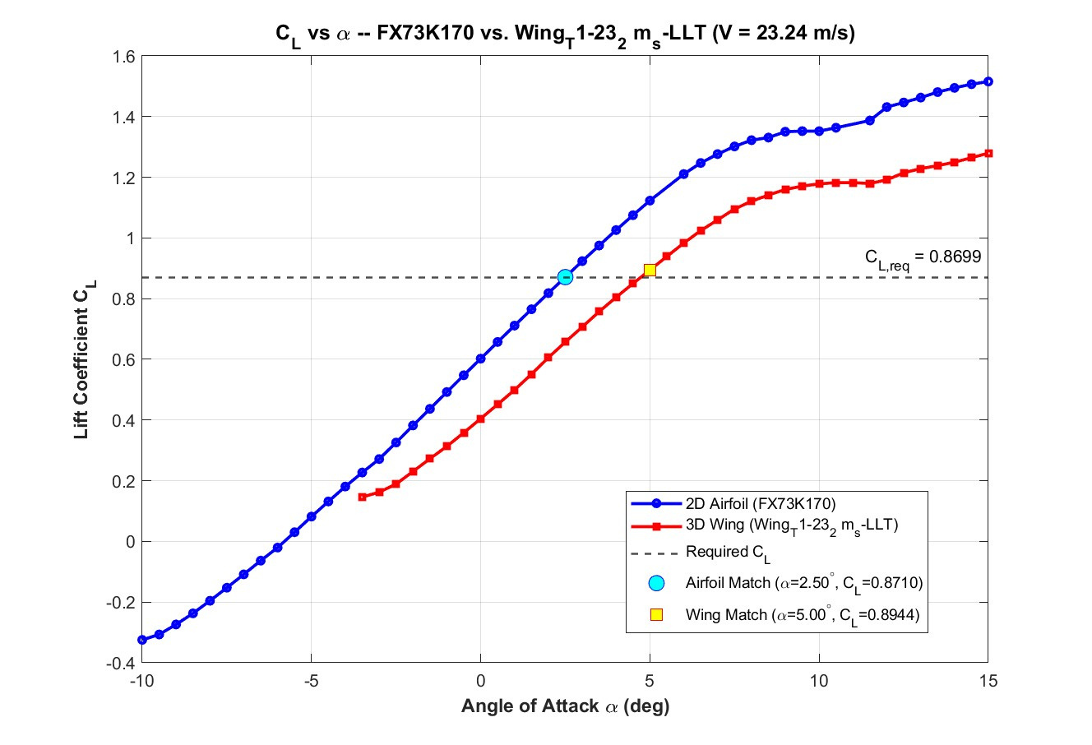
After adding the taper to the wing
17

Slide 18
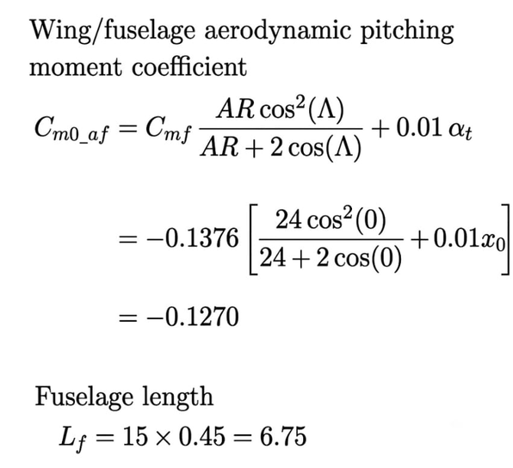
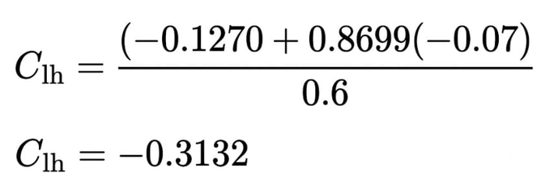
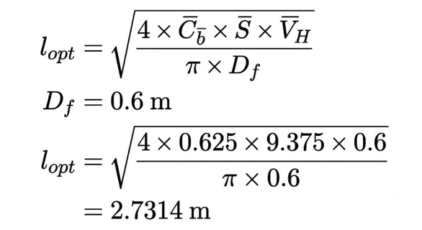
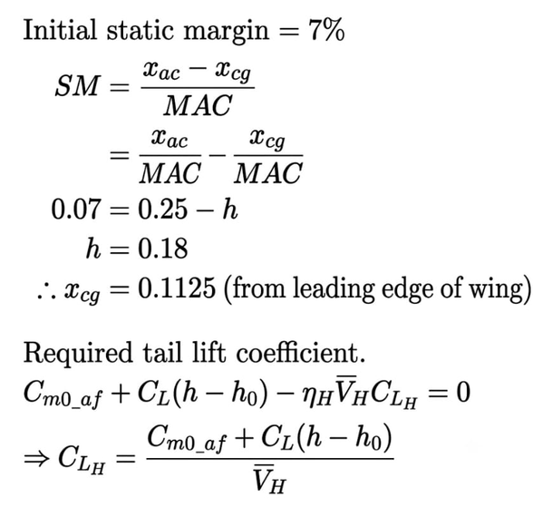
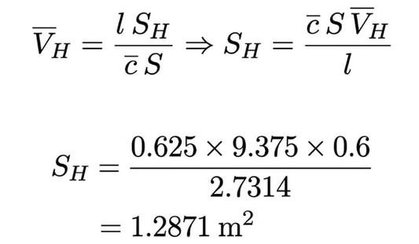
Taill design calculations
Wing Area = 9.375 m2
CL (required) = 0.8699
Horizontal tail volume = VH = 0.6
Optimum Tail arm
Tail Aspect Ratio (AR) : 16.00
Calculated Tail Span(b): 4.5380 m
Calculated Tail Chord(c): 0.2836 m
Tail area
18

Slide 19
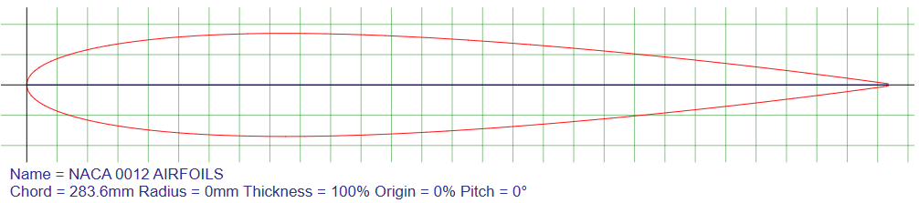
Airfoil selection for tail and AoA
Airfoil - NACA0012
Similarly as for the wing using polar values:
Required AoA of airfoil : -2.793°
Infinite wing (2D aerofoil) lift curve slope, 𝑎0 : 6.9828 /rad (0.1219 /degree)
IFinite wing lift curve slope; 𝑎 : : 6.1310 /rad(0.1070 /deg)
AOA of Tail = -2.9269 deg
19

Slide 20
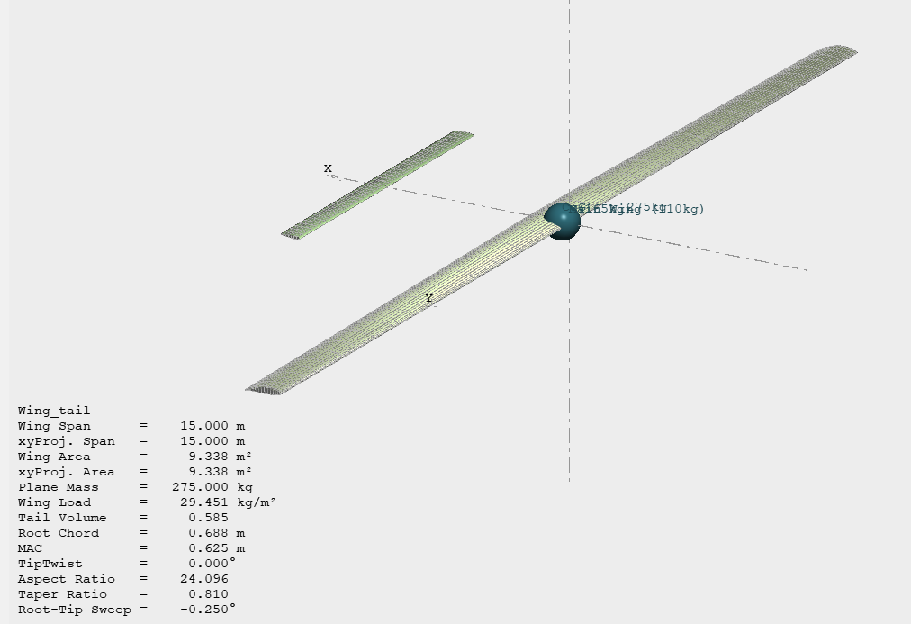
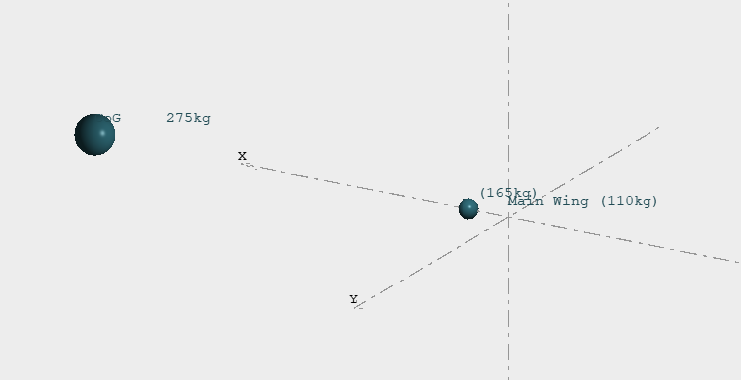
XFLR 5 model of wing and tail
20

Slide 21
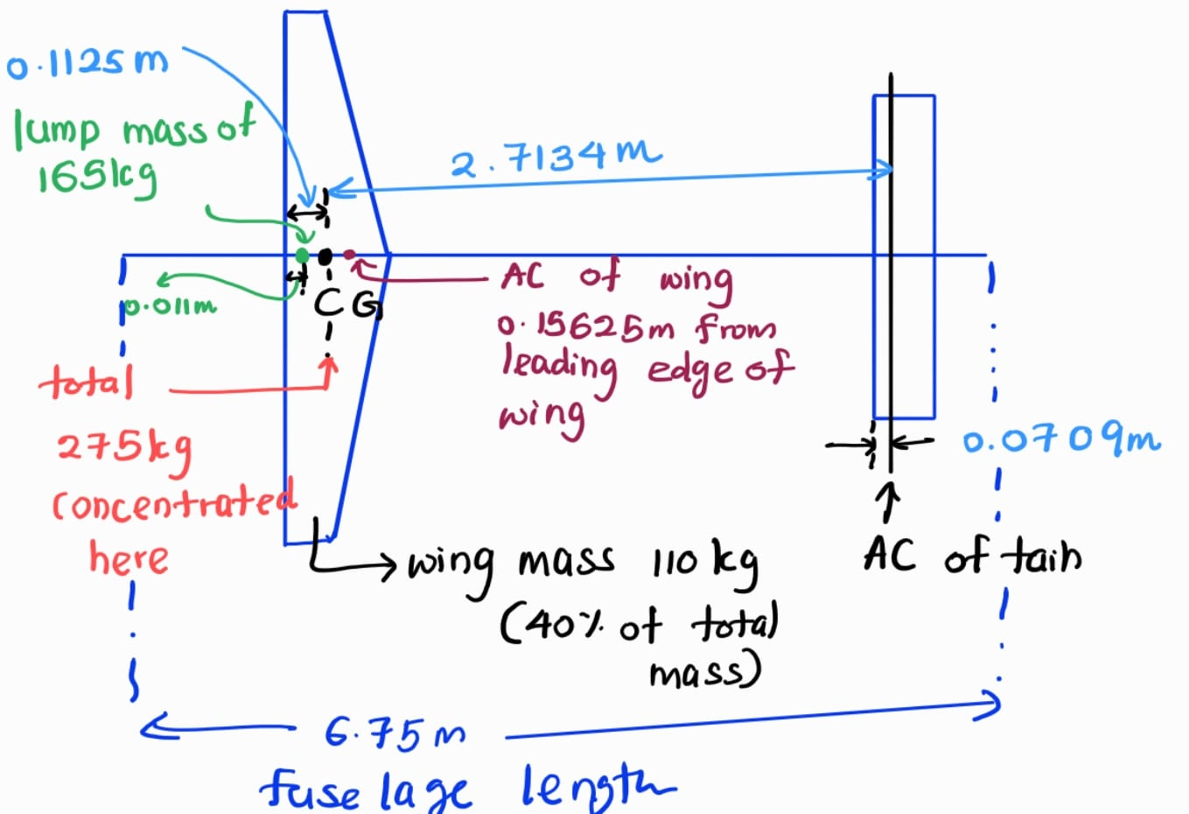
21

Slide 22
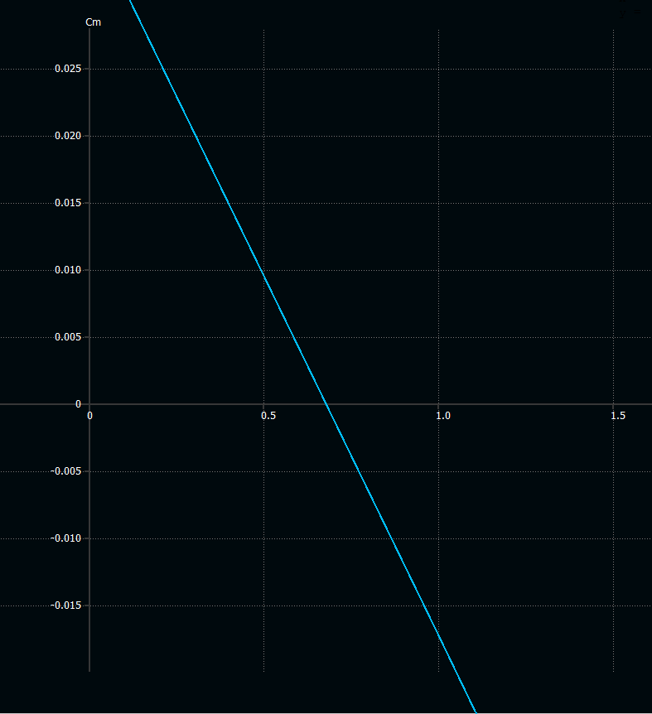
From the CM vs alpha curve which is the resultant of the wing and the tail has the trim angle less a than 1 degree. Therefore , can consider as almost zero

Slide 23
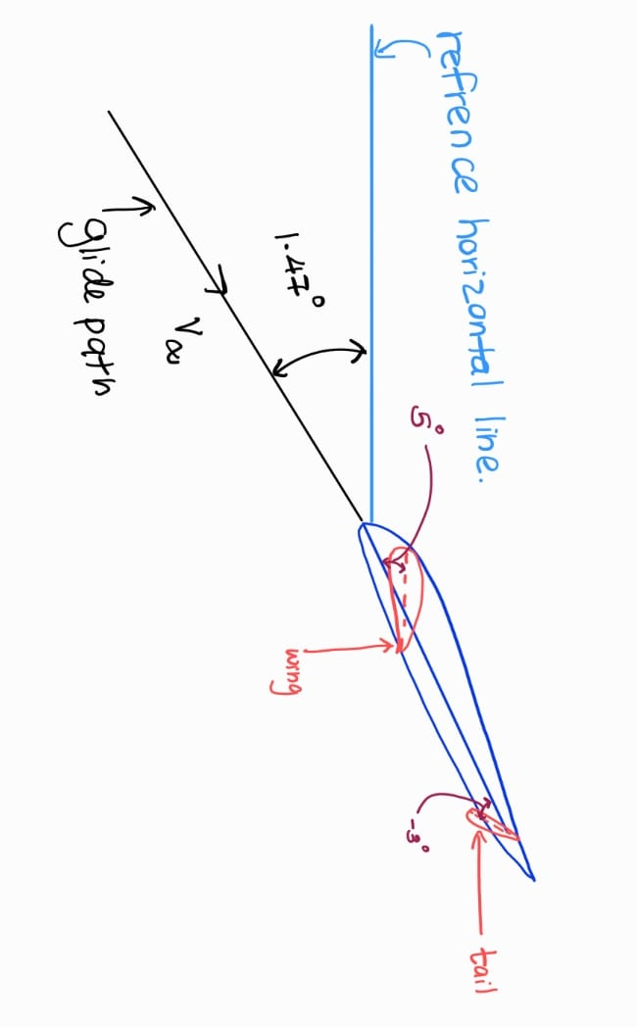
22

Slide 24
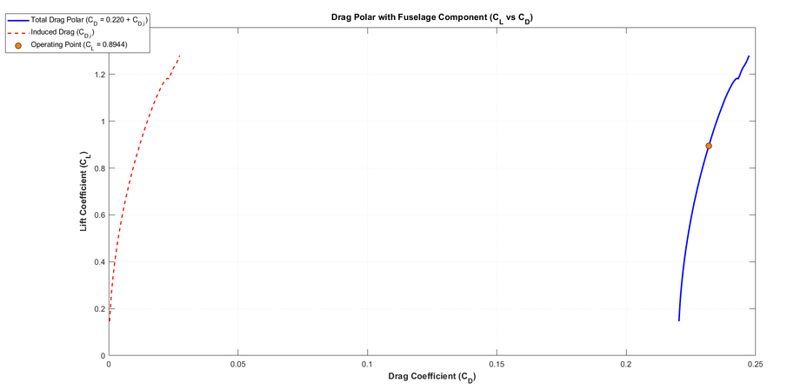
Fuselage Selection
For sailplanes the CD0 vary in a range of : 0.012 - 0.95
Choosed an arbitatry value of CD0 = 0.2200
Wing Profile Drag (CD0_wing) = 0.0120
At CL = 0.8944,
Induced Drag (CDi) : 0.011878
Total Drag (CD_total) : 0.231878
Fuselage Profile Drag (CD_fuselage) : 0.208000
Using the equation
CD = CD0 + CDi
the grad polar curve of aircraft is being plotted around the CL value generated.
We have choose a fuselage shape that has this amount of profile drag coeffcient or less than that
23

Slide 25
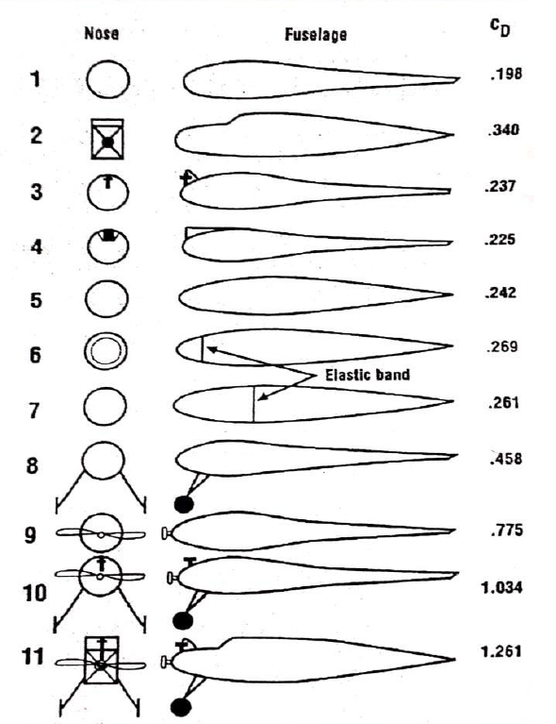
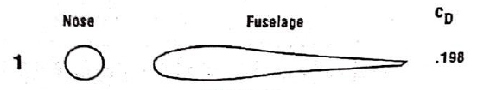
Different fuselage shapes and relevant profile drag coefficient
Selected fuselage shape
[1] A. Singh, “Designing Procedure for Micro-Class Remote Controlled Fixed Wing VTOL,” International Journal of Engineering Science and Computing (IJESC), vol. 9, no. 9, 2019.
24

Slide 26
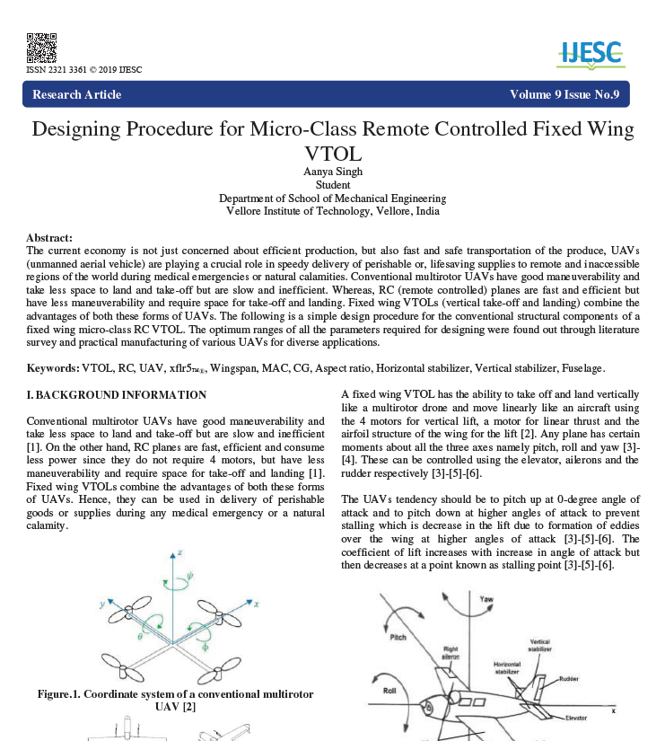
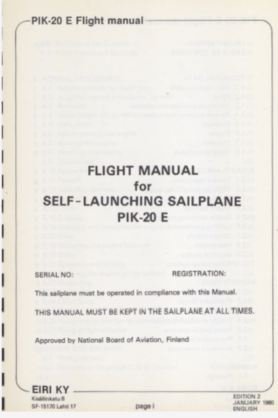
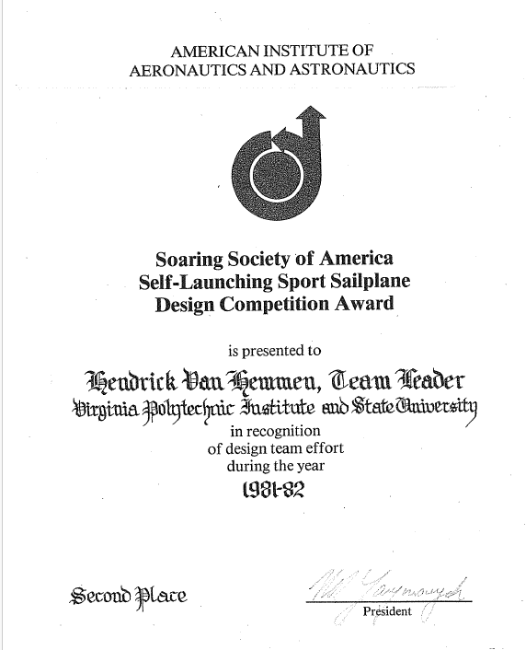
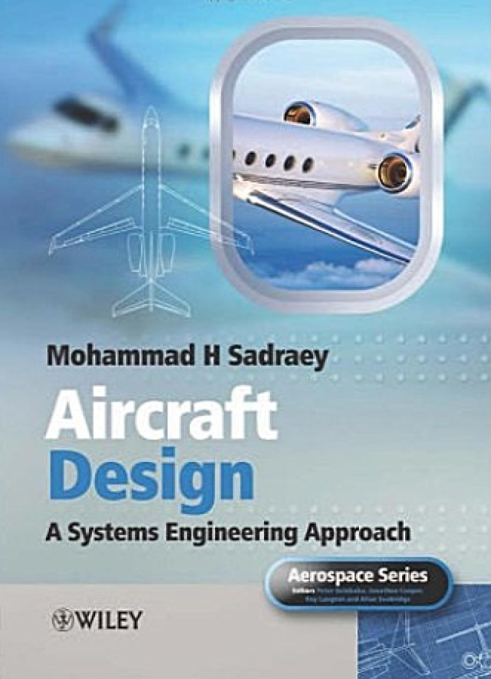
References
[1] A. Singh, “Designing Procedure for Micro-Class Remote Controlled Fixed Wing VTOL,” International Journal of Engineering Science and Computing (IJESC), vol. 9, no. 9, 2019.
[2] Flight Manual for Self-Launching Sailplane PIK-20, approved by the National Board of Aviation, Finland.
[3] Soaring Society of America, “Self-Launching Sport Sailplane Design Competition Award,” award certificate presented to H. Van Neermeulen, Virginia Polytechnic Institute and State University, Second Place, 1981–1982.
[4] M. H. Sadraey, Aircraft Design: A Systems Engineering Approach. Hoboken, NJ, USA: John Wiley & Sons, 2012.

Slide 27
THANK YOU

